Slide 1

CSE 3121
Database Management Systems
Session: 2016-17
Dr. Asif Zaman
Associate Professor, CSE, RU

Slide 2
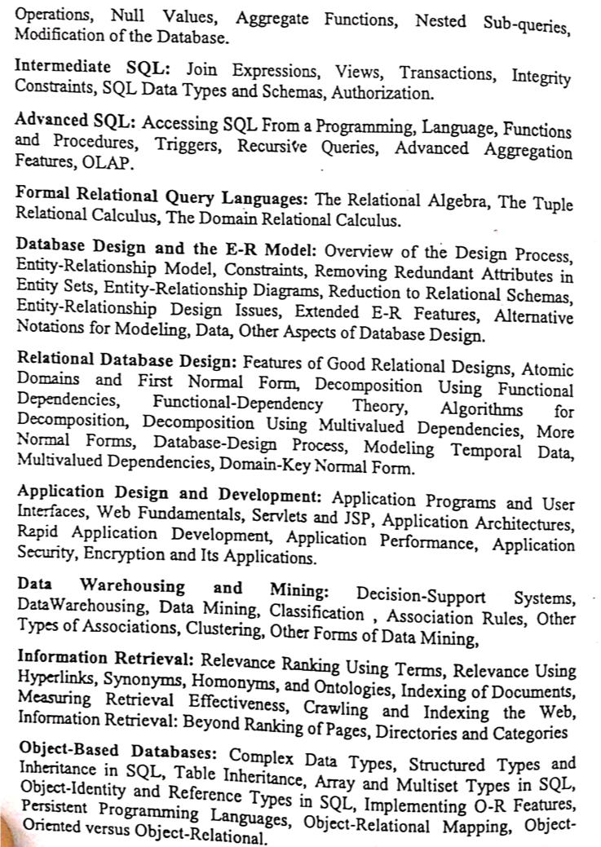

Slide 3
Physical Storage Media
Speed with which data can be accessed.
Cost per unit of data.
Reliability
data loss on power failure or system crash
physical failure of the storage device

Slide 4
Physical Storage Media
Can differentiate storage into:
volatile storage: loses contents when power is switched off
non-volatile storage:
Contents persist even when power is switched off.
Includes secondary and tertiary storage, as well as batter- backed up main-memory.

Slide 5
Physical Storage Media
Cache – fastest and most costly form of storage; volatile; managed by the computer system hardware.
Main memory:
fast access (10s to 100s of nanoseconds; 1 nanosecond = 10^{–9} seconds)
generally too small (or too expensive) to store the entire database
capacities of up to a few Gigabytes widely used currently
Capacities have gone up and per-byte costs have decreased steadily and rapidly (roughly factor of 2 every 2 to 3 years)
Volatile — contents of main memory are usually lost if a power failure or system crash occurs.

Slide 6
Physical Storage Media (Cont.)
Flash memory
Data survives power failure
Data can be written at a location only once, but location can be erased and written to again
Can support only a limited number (10K – 1M) of write/erase cycles.
Erasing of memory has to be done to an entire bank of memory
Reads are roughly as fast as main memory
But writes are slow (few microseconds), erase is slower
Widely used in embedded devices such as digital cameras, phones, and USB keys

Slide 7
Physical Storage Media (Cont.)
Magnetic-disk
Data is stored on spinning disk, and read/written magnetically
Primary medium for the long-term storage of data; typically stores entire database.
Data must be moved from disk to main memory for access, and written back for storage
Much slower access than main memory (more on this later)

Slide 8
Physical Storage Media (Cont.)
direct-access – possible to read data on disk in any order, unlike magnetic tape
Capacities range up to roughly 1.5 TB as of 2009
Much larger capacity and cost/byte than main memory/flash memory
Growing constantly and rapidly with technology improvements (factor of 2 to 3 every 2 years)
Survives power failures and system crashes
disk failure can destroy data, but is rare

Slide 9
Physical Storage Media (Cont.)
Optical storage
non-volatile, data is read optically from a spinning disk using a laser
CD-ROM (640 MB) and DVD (4.7 to 17 GB) most popular forms
Blu-ray disks: 27 GB to 54 GB

Slide 10
Physical Storage Media (Cont.)
Write-one, read-many (WORM) optical disks used for archival storage (CD-R, DVD-R, DVD+R)
Multiple write versions also available (CD-RW, DVD-RW, DVD+RW, and DVD-RAM)
Reads and writes are slower than with magnetic disk

Slide 11
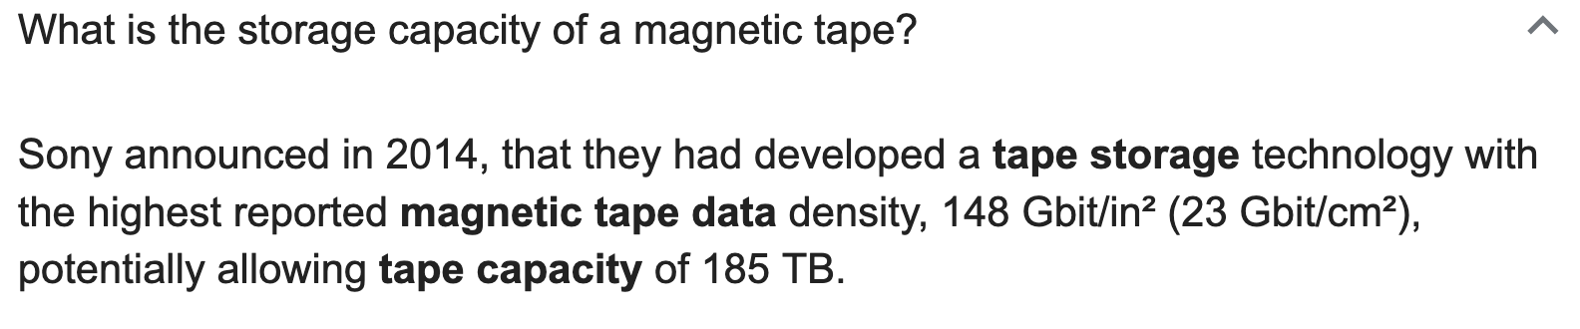
Physical Storage Media (Cont.)
Tape storage
non-volatile, used primarily for backup (to recover from disk failure), and for archival data
sequential-access – much slower than disk
very high capacity (40 to 300 GB tapes available)
tape can be removed from drive ⇒ storage costs much cheaper than disk, but drives are expensive
Tape jukeboxes available for storing massive amounts of data
hundreds of terabytes (1 terabyte = 10⁹ bytes) to even multiple petabytes (1 petabyte = 10¹² bytes)

Slide 12
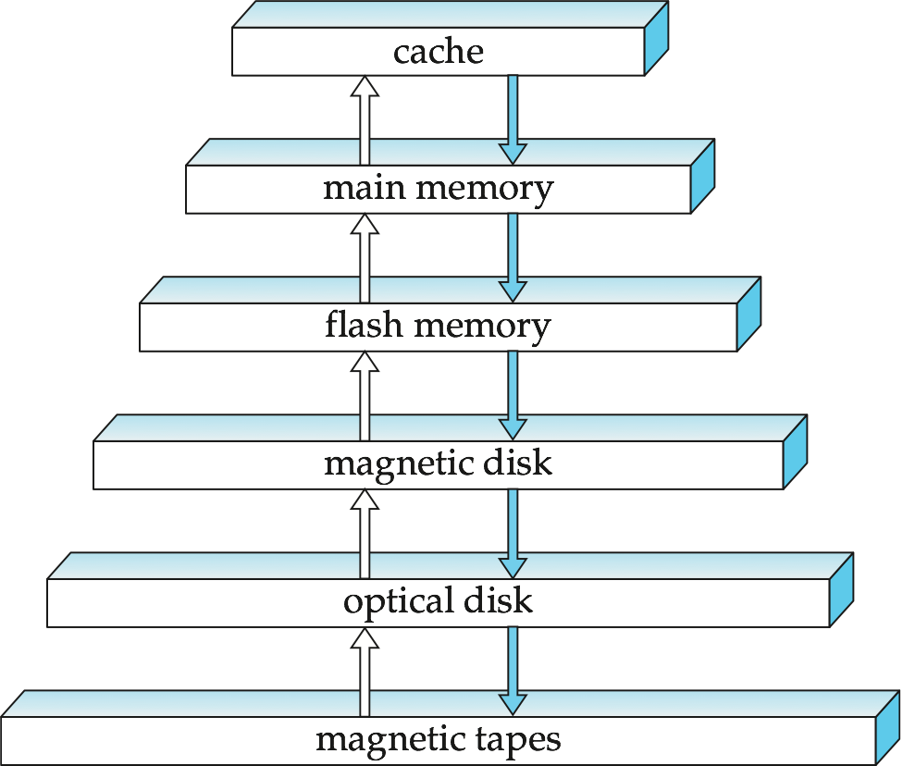
Storage Hierarchy

Slide 13
Storage Hierarchy (Cont.)
primary storage: Fastest media but volatile (cache, main memory).
secondary storage: next level in hierarchy, non-volatile, moderately fast access time
also called on-line storage
E.g. flash memory, magnetic disks
tertiary storage: lowest level in hierarchy, non-volatile, slow access time
also called off-line storage
E.g. magnetic tape, optical storage

Slide 14
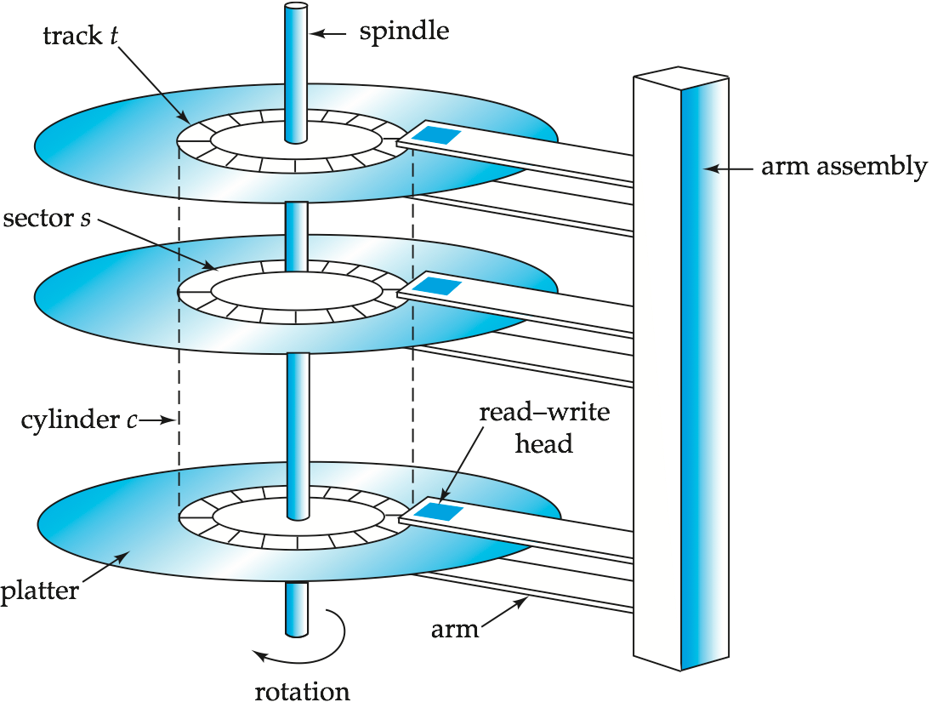
Magnetic Hard Disk Mechanism
NOTE: Diagram is schematic, and simplifies the structure of actual disk drives

Slide 15
Magnetic Disks
Read-write head
Positioned very close to the platter surface (almost touching it)
Reads or writes magnetically encoded information.
Surface of platter divided into circular tracks
Over 50K-100K tracks per platter on typical hard disks
Each track is divided into sectors.
A sector is the smallest unit of data that can be read or written.
Sector size typically 512 bytes

Slide 16
Magnetic Disks
Typical sectors per track: 500 to 1000 (on inner tracks) to 1000 to 2000 (on outer tracks)
To read/write a sector
disk arm swings to position head on right track
platter spins continually; data is read/written as sector passes under head
Head-disk assemblies
multiple disk platters on a single spindle (1 to 5 usually)
one head per platter, mounted on a common arm.
Cylinder i consists of i^{th} track of all the platters

Slide 17
Magnetic Disks (Cont.)
Earlier generation disks were susceptible to head-crashes
Surface of earlier generation disks had metal-oxide coatings which would disintegrate on head crash and damage all data on disk
Current generation disks are less susceptible to such disastrous failures, although individual sectors may get corrupted
Disk controller – interfaces between the computer system and the disk drive hardware.
accepts high-level commands to read or write a sector

Slide 18
Magnetic Disks (Cont.)
initiates actions such as moving the disk arm to the right track and actually reading or writing the data
Computes and attaches checksums to each sector to verify that data is read back correctly
If data is corrupted, with very high probability stored checksum won’t match recomputed checksum
Ensures successful writing by reading back sector after writing it
Performs remapping of bad sectors

Slide 19
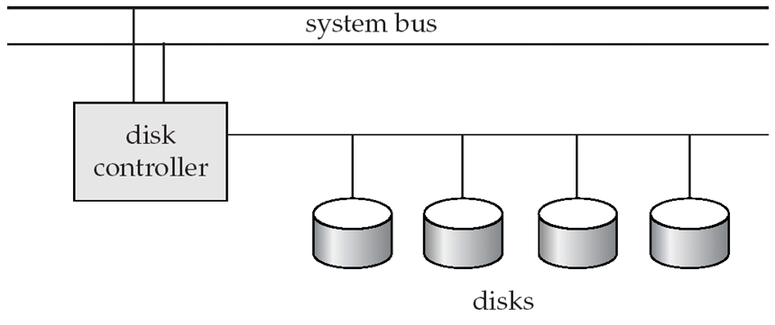
Disk Subsystem
Multiple disks connected to a computer system through a controller
Controllers functionality (checksum, bad sector remapping) often carried out by individual disks; reduces load on controller
Disk interface standards families
ATA (AT adaptor) range of standards
SATA (Serial ATA)
SCSI (Small Computer System Interconnect) range of standards
SAS (Serial Attached SCSI)
Several variants of each standard (different speeds and capabilities)

Slide 20
Disk Subsystem
Disks usually connected directly to computer system
In Storage Area Networks (SAN), a large number of disks are connected by a high-speed network to a number of servers
The disks are usually organized locally using a storage organization technique called redundant arrays of independent disks (RAID) to give the servers a logical view of a very large and very reliable disk.
In Network Attached Storage (NAS) networked storage provides a file system interface using networked file system protocol, instead of providing a disk system interface

Slide 21
Performance Measures of Disks
Access time – the time it takes from when a read or write request is issued to when data transfer begins.
Consists of:
Seek time – time it takes to reposition the arm over the correct track.
Average seek time is 1/2 the worst case seek time.
4 to 10 milliseconds on typical disks
Rotational latency – time it takes for the sector to be accessed to appear under the head.
Average latency is 1/2 of the worst case latency.
4 to 11 milliseconds on typical disks (5400 to 15000 r.p.m.)

Slide 22
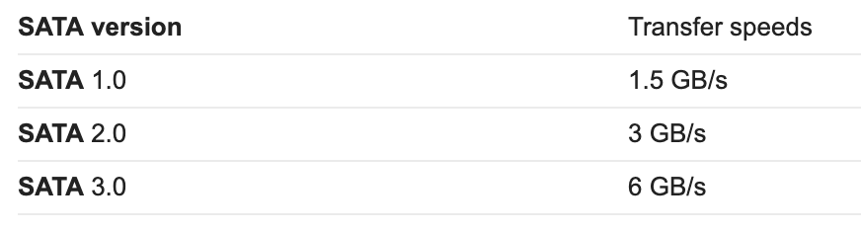
Performance Measures of Disks
Data-transfer rate – the rate at which data can be retrieved from or stored to the disk.
25 to 100 MB per second max rate, lower for inner tracks
Multiple disks may share a controller, so rate that controller can handle is also important
SATA: 150 MB/sec, SATA-II 3Gb (300 MB/sec)
Ultra 320 SCSI: 320 MB/s, SAS (3 to 6 Gb/sec)
Fiber Channel (FC2Gb or 4Gb): 256 to 512 MB/s

Slide 23
Performance Measures (Cont.)
Mean time to failure (MTTF) – the average time the disk is expected to run continuously without any failure.
Typically 3 to 5 years
Probability of failure of new disks is quite low, corresponding to a “theoretical MTTF” of 500,000 to 1,200,000 hours for a new disk
E.g., an MTTF of 1,200,000 hours for a new disk means that given 1000 relatively new disks, on an average one will fail every 1200 hours
MTTF decreases as disk ages

Slide 24
Optimization of Disk-Block Access
Block – a contiguous sequence of sectors from a single track
data is transferred between disk and main memory in blocks
sizes range from 512 bytes to several kilobytes
Smaller blocks: more transfers from disk
Larger blocks: more space wasted due to partially filled blocks
Typical block sizes today range from 4 to 16 kilobytes

Slide 25
Optimization of Disk Block Access
File organization – optimize block access time by organizing the blocks to correspond to how data will be accessed
E.g. Store related information on the same or nearby cylinders.
Files may get fragmented over time
E.g. if data is inserted to/deleted from the file
Or free blocks on disk are scattered, and newly created file has its blocks scattered over the disk
Sequential access to a fragmented file results in increased disk arm movement
Some systems have utilities to defragment the file system, in order to speed up file access

Slide 26
RAID
RAID: Redundant Arrays of Independent Disks
disk organization techniques that manage a large numbers of disks, providing a view of a single disk of
high capacity and high speed by using multiple disks in parallel,
high reliability by storing data redundantly, so that data can be recovered even if a disk fails
The chance that some disk out of a set of N disks will fail is much higher than the chance that a specific single disk will fail.

Slide 27
RAID
E.g., a system with 100 disks, each with MTTF of 100,000 hours (approx. 11 years), will have a system MTTF of 1000 hours (approx. 41 days)
Techniques for using redundancy to avoid data loss are critical with large numbers of disks
Originally a cost-effective alternative to large, expensive disks
I in RAID originally stood for ``inexpensive’’
Today RAIDs are used for their higher reliability and bandwidth.
The “I” is interpreted as independent

Slide 28
Improvement of Reliability via Redundancy
Redundancy – store extra information that can be used to rebuild information lost in a disk failure
E.g., Mirroring (or shadowing)
Duplicate every disk. Logical disk consists of two physical disks.
Every write is carried out on both disks
Reads can take place from either disk
If one disk in a pair fails, data still available in the other

Slide 29
Improvement of Reliability via Redundancy
Data loss would occur only if a disk fails, and its mirror disk also fails before the system is repaired
Probability of combined event is very small
Except for dependent failure modes such as fire or building collapse or electrical power surges
Mean time to data loss depends on mean time to failure, and mean time to repair
E.g. MTTF of 100,000 hours, mean time to repair of 10 hours gives mean time to data loss of 500*10⁶ hours (or 57,000 years) for a mirrored pair of disks (ignoring dependent failure modes)

Slide 30
Improvement in Performance via Parallelism
Two main goals of parallelism in a disk system:
1. Load balance multiple small accesses to increase throughput
2. Parallelize large accesses to reduce response time.
Improve transfer rate by striping data across multiple disks.
Bit-level striping – split the bits of each byte across multiple disks
In an array of eight disks, write bit i of each byte to disk i.
Each access can read data at eight times the rate of a single disk.
But seek/access time worse than for a single disk
Bit level striping is not used much any more

Slide 31
Improvement in Performance via Parallelism
Block-level striping – with n disks, block i of a file goes to disk (i mod n) + 1
Requests for different blocks can run in parallel if the blocks reside on different disks
A request for a long sequence of blocks can utilize all disks in parallel

Slide 32
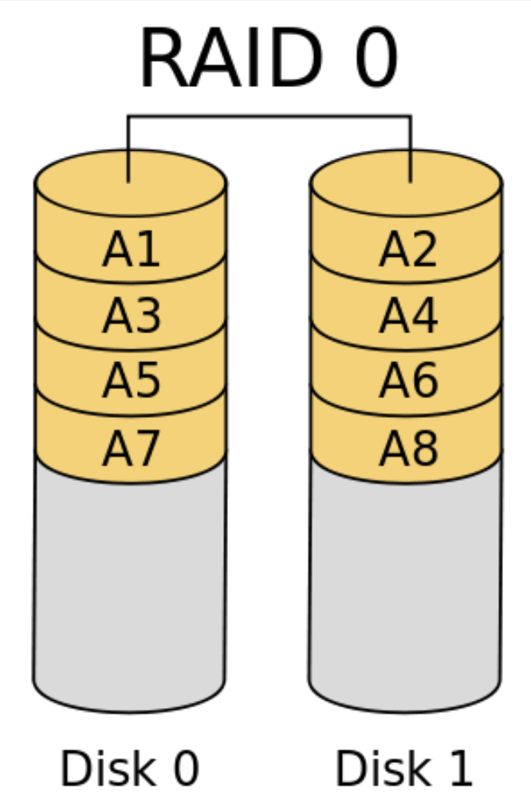
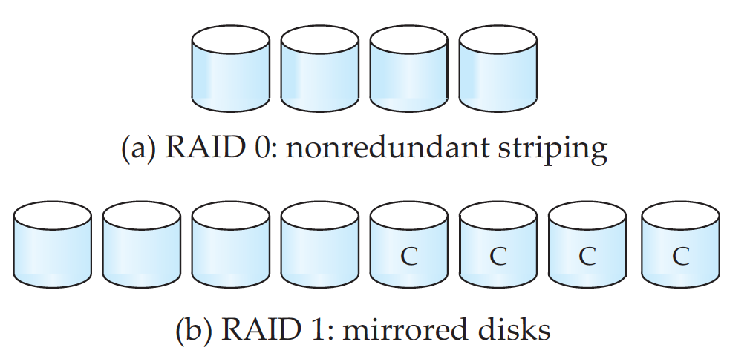
RAID Levels
RAID Level 0: Block striping; non-redundant.
Used in high-performance applications where data loss is not critical.

Slide 33
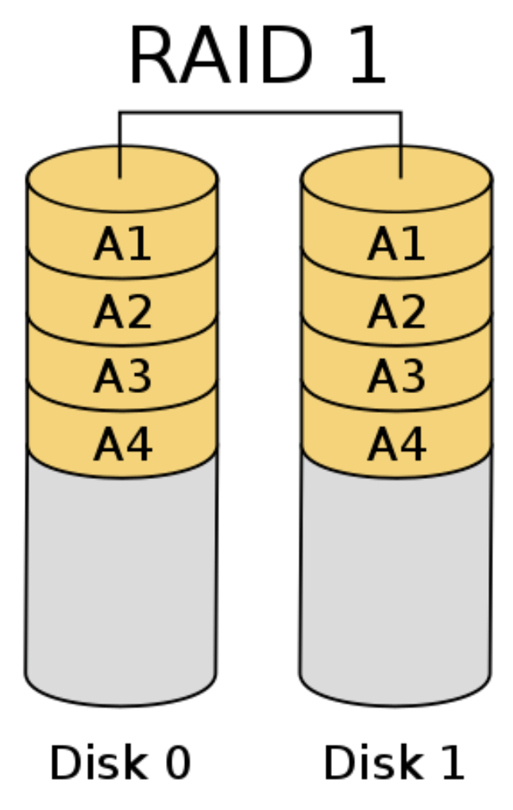
RAID Levels
RAID Level 1: Mirrored disks with block striping
Offers best write performance.
Popular for applications such as storing log files in a database system.

Slide 34
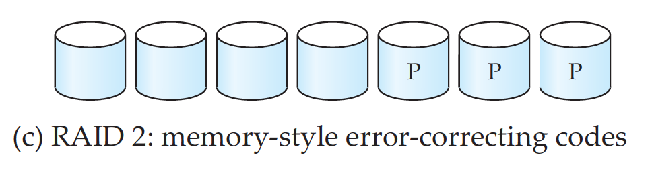
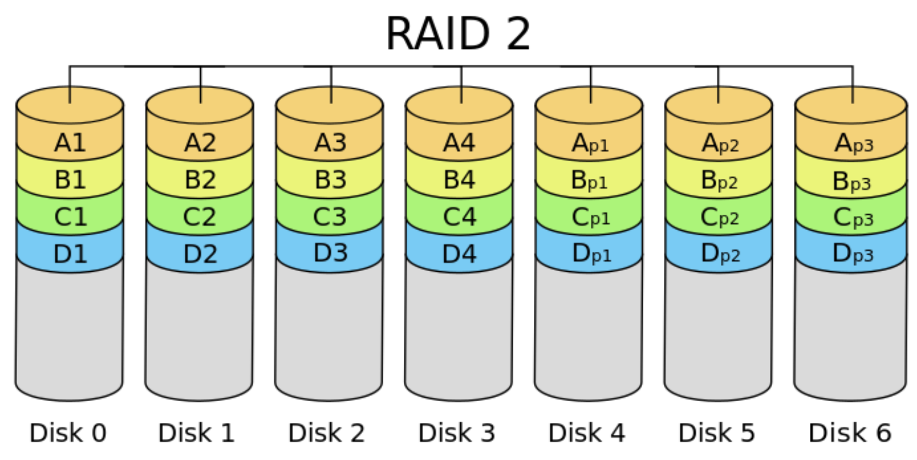
RAID Levels (Cont.)
RAID Level 2: Memory-Style Error-Correcting-Codes (ECC) with bit striping.

Slide 35
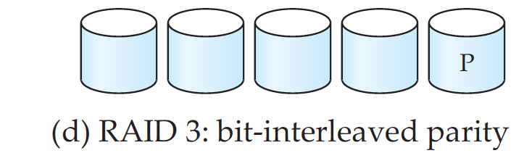
RAID Levels (Cont.)
RAID Level 3: Bit-Interleaved Parity
a single parity bit is enough for error correction, not just detection, since we know which disk has failed
When writing data, corresponding parity bits must also be computed and written to a parity bit disk
To recover data in a damaged disk, compute XOR of bits from other disks (including parity bit disk)
Faster data transfer than with a single disk, but fewer I/Os per second since every disk has to participate in every I/O.
Subsumes Level 2 (provides all its benefits, at lower cost).

Slide 36
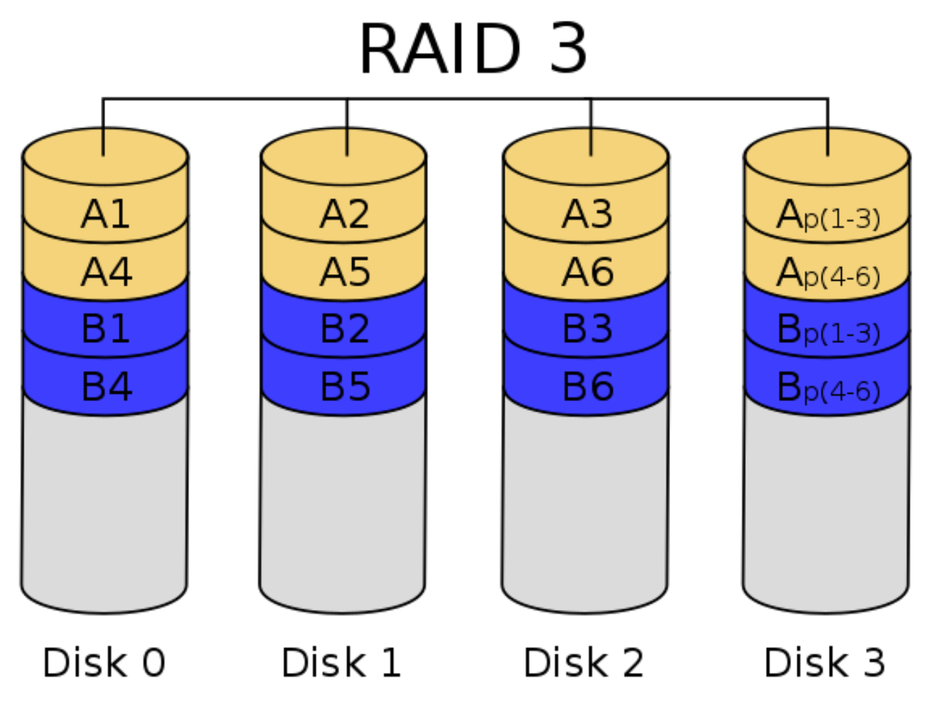

Slide 37
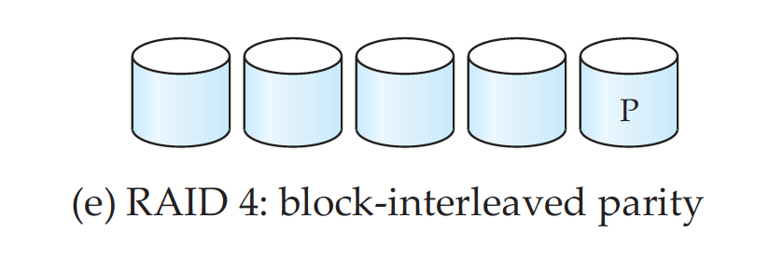
RAID Levels (Cont.)
RAID Level 4: Block-Interleaved Parity; uses block-level striping, and keeps a parity block on a separate disk for corresponding blocks from N other disks.
When writing data block, corresponding block of parity bits must also be computed and written to parity disk
To find value of a damaged block, compute XOR of bits from corresponding blocks (including parity block) from other disks.

Slide 38
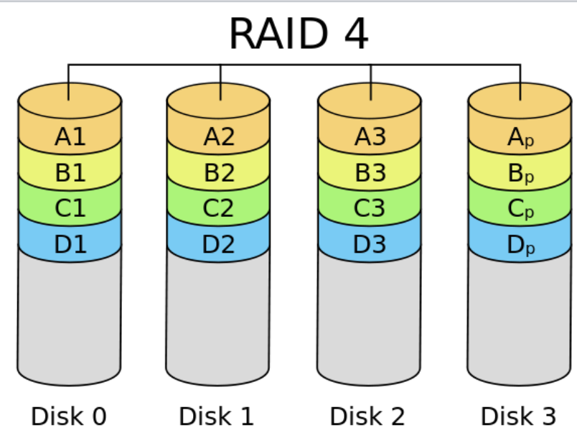

Slide 39
RAID Levels (Cont.)
RAID Level 4 (Cont.)
Provides higher I/O rates for independent block reads than Level 3
block read goes to a single disk, so blocks stored on different disks can be read in parallel
Provides high transfer rates for reads of multiple blocks than no-striping
Before writing a block, parity data must be computed
Can be done by using old parity block, old value of current block and new value of current block (2 block reads + 2 block writes)
Or by recomputing the parity value using the new values of blocks corresponding to the parity block
More efficient for writing large amounts of data sequentially
Parity block becomes a bottleneck for independent block writes since every block write also writes to parity disk

Slide 40
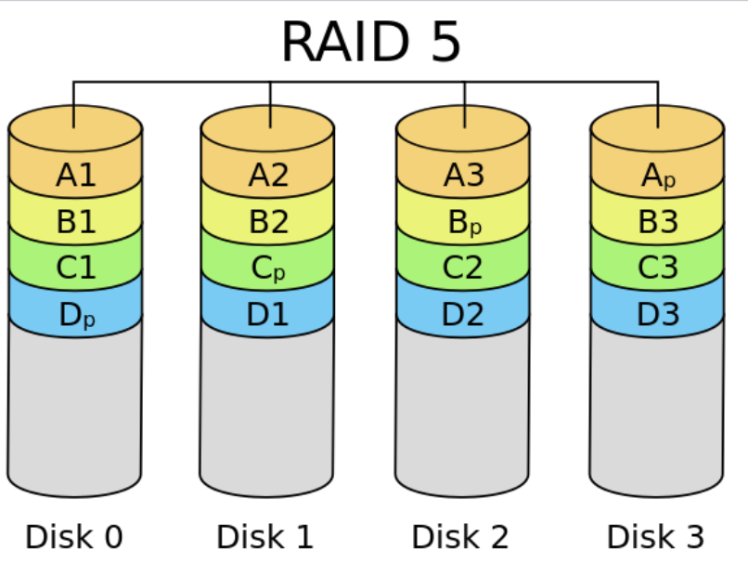
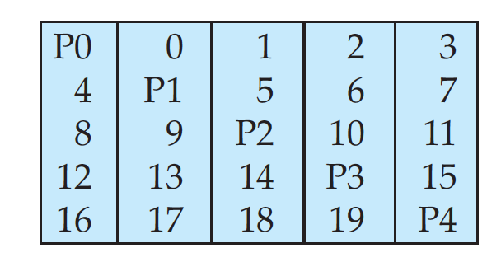
RAID Levels (Cont.)
RAID Level 5: Block-Interleaved Distributed Parity; partitions data and parity among all N + 1 disks, rather than storing data in N disks and parity in 1 disk.
E.g., with 5 disks, parity block for nth set of blocks is stored on disk (n mod 5) + 1, with the data blocks stored on the other 4 disks.

Slide 41
RAID Levels (Cont.)
RAID Level 5 (Cont.)
Higher I/O rates than Level 4.
Block writes occur in parallel if the blocks and their parity blocks are on different disks.
Subsumes Level 4: provides same benefits, but avoids bottleneck of parity disk.
RAID Level 6: P+Q Redundancy scheme; similar to Level 5, but stores extra redundant information to guard against multiple disk failures.
Better reliability than Level 5 at a higher cost; not used as widely.

Slide 42
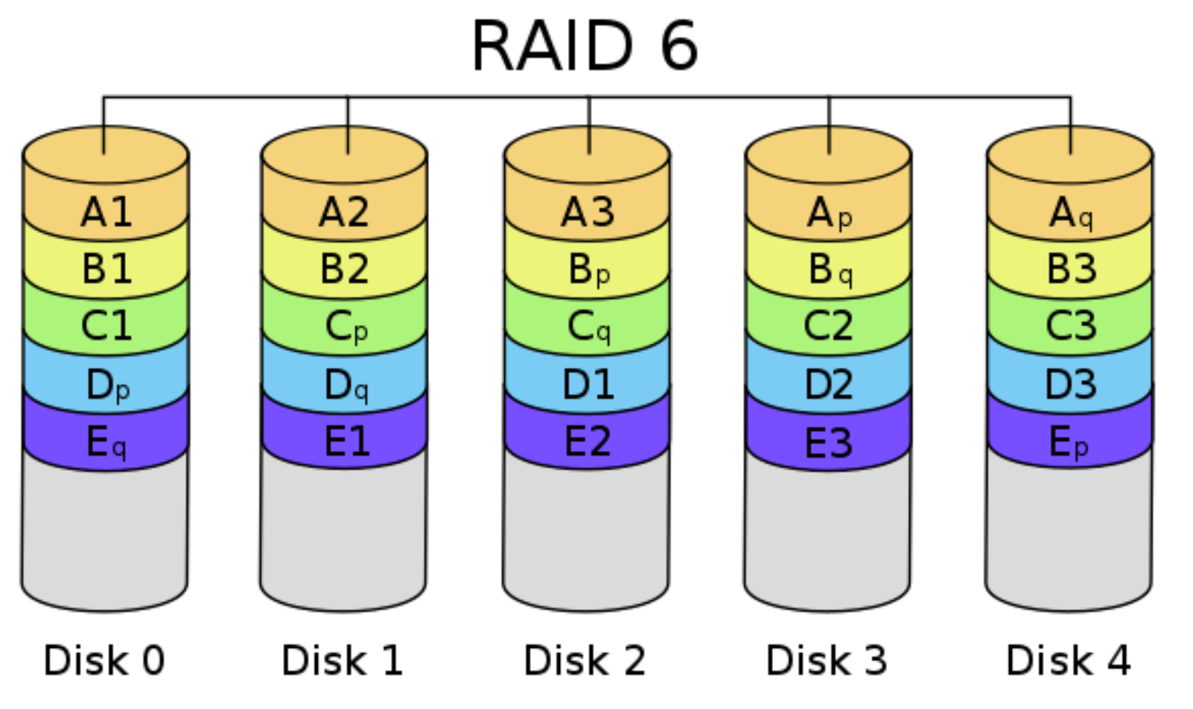

Slide 43
Choice of RAID Level
Factors in choosing RAID level
Monetary cost
Performance: Number of I/O operations per second, and bandwidth during normal operation
Performance during failure
Performance during rebuild of failed disk Including time taken to rebuild failed disk

Slide 44
Choice of RAID Level
RAID 0 is used only when data safety is not important
E.g. data can be recovered quickly from other sources
Level 2 and 4 never used since they are subsumed by 3 and 5
Level 3 is not used anymore since bit-striping forces single block reads to access all disks, wasting disk arm movement, which block striping (level 5) avoids
Level 6 is rarely used since levels 1 and 5 offer adequate safety for most applications

Slide 45
Choice of RAID Level (Cont.)
Level 1 provides much better write performance than level 5
Level 5 requires at least 2 block reads and 2 block writes to write a single block, whereas Level 1 only requires 2 block writes
Level 1 preferred for high update environments such as log disks
Level 1 had higher storage cost than level 5
disk drive capacities increasing rapidly (50%/year) whereas disk access times have decreased much less (x 3 in 10 years)

Slide 46
Choice of RAID Level (Cont.)
I/O requirements have increased greatly, e.g. for Web servers
When enough disks have been bought to satisfy required rate of I/O, they often have spare storage capacity
so there is often no extra monetary cost for Level 1!
Level 5 is preferred for applications with low update rate, and large amounts of data
Level 1 is preferred for all other applications

Slide 47
End of Class

